Slide 1
VisCalcML Figures
v0.1

Slide 2
Patrick To-Do
TEDIOUS - Design graphical abstract (fig. 1)
EASY - Make line chart and histogram of KV40 for interesting/representative molecules curated from Sibo (fig. 5)
HARDish – randomly select ~5000 Surge isomers and make KV40 histogram (fig. 6)
  Or just do it for all Surge isomers
HARD – Make VI-KV40 plot for select Surge isomers (fig. 7)

Slide 3
Main Article Figures
Figures are put in preliminary order

Slide 4
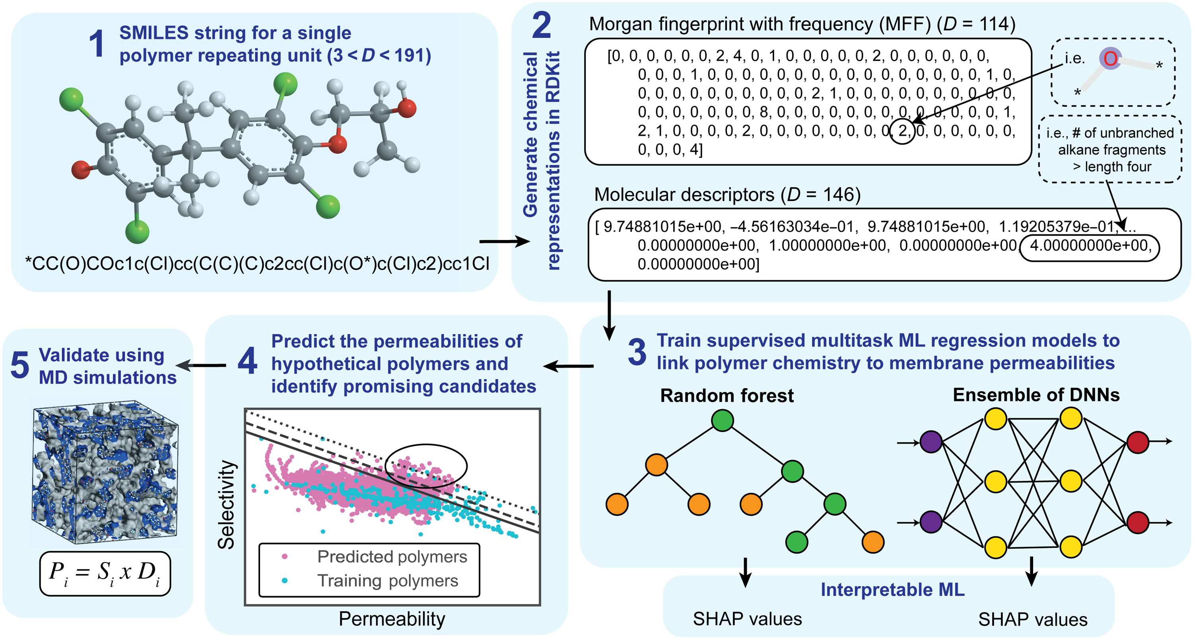
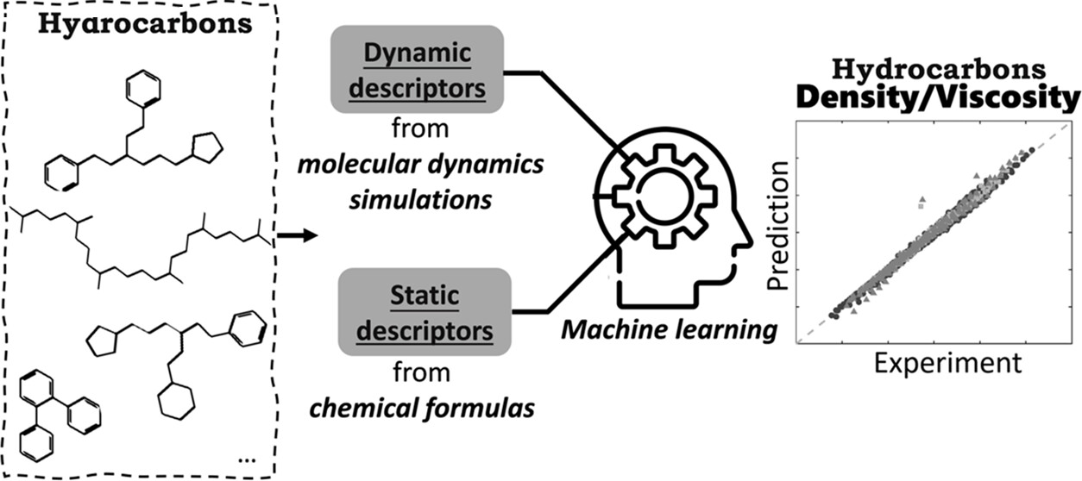
Fig. 1: High-Level Diagram of Workflow
Have to work on this. Can do after I leave
Literature examples:
Panwar et al, Yang et al

Slide 5
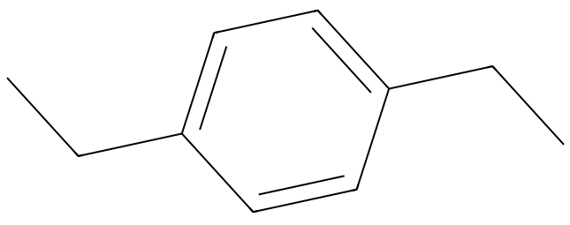
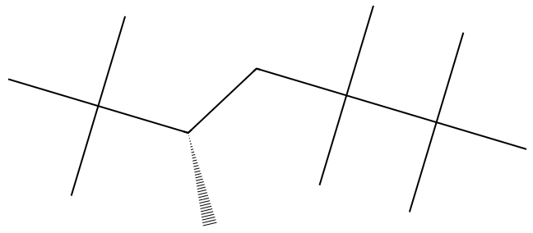
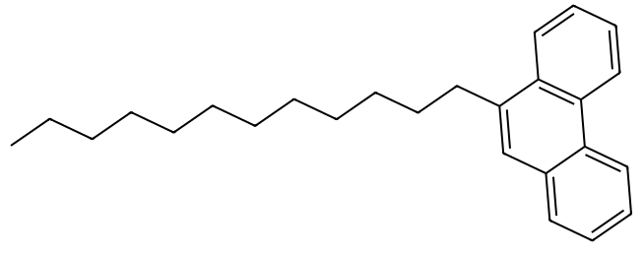
Fig. 1: High-Level Diagram of Workflow
1.
2.
Train 16 Gradient Boosting Regressors
3.
[ * * * * * * ... * * * * * *, T (K) ]
+ … +
1375 KV-Temperature Data Points from 8 Sources
Using Descriptors or Morgan Fingerprint with Frequency
5.
Screen Expert-Curated Molecules and Millions of C₃₀H₆₂ Isomers from Surge
4.
Candidate Lubricant
KV
VisCalcML
Temperature

Slide 6
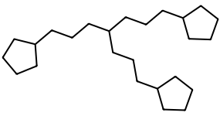
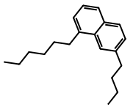
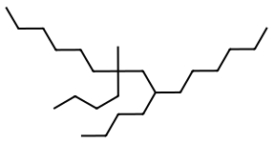
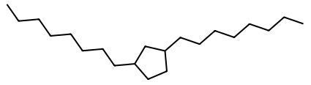
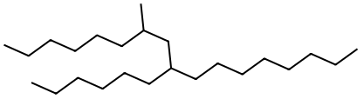
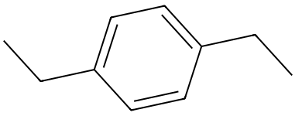
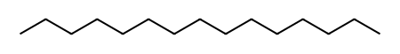

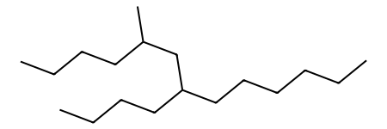
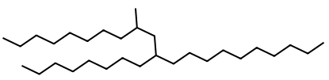
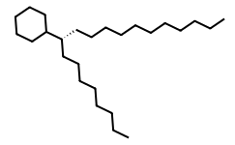
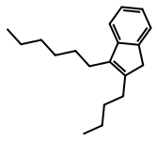
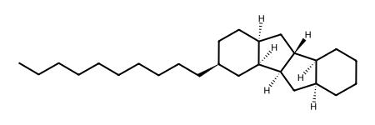
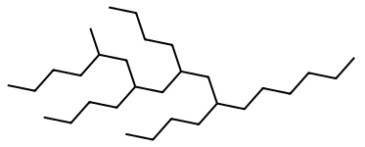
Fig. 2: Example Molecules from Test/Train Sets
Training Set
394 Unique Molecules
1351 KV-Temperature Measurements
Test Set
12 Unique Molecules
24 KV-Temperature Measurements

Slide 7
Fig. 3: VisCalcML Train/Test Performance

Slide 8
Fig. 4: Benchmarking VisCalcML vs Panwar & CosmoTherm
(A)
(B)
(C)
R²: 0.9865663
R²: 0.736056327
R²: -13.20184705
Note: R² can be negative in a ML context if the model does arbitrarily worse than a constant model which always predicts the mean value of y_true.
Can arrange these in a square shape for aesthetics. Maybe the fourth tile in the square can be a quick bar chart comparing R² or inference time for all these models.

Slide 9
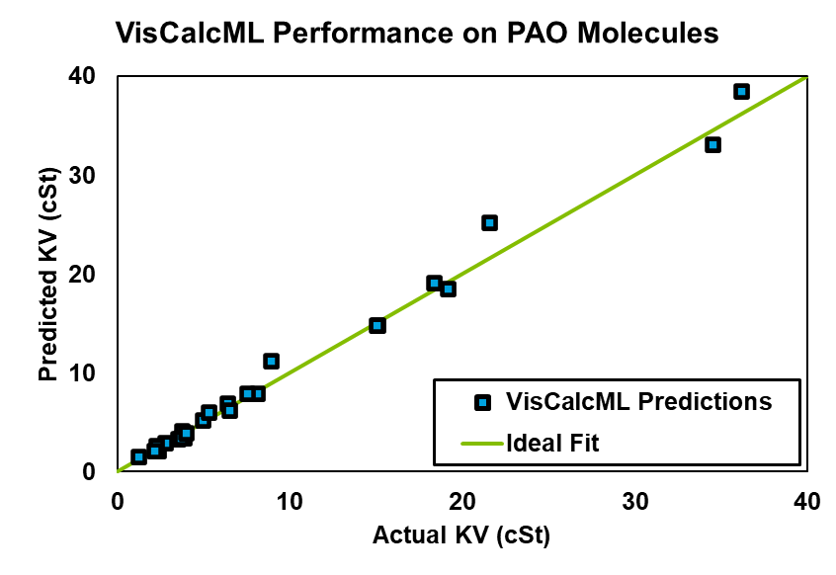
Fig. 4: Benchmarking VisCalcML vs Panwar & CosmoTherm
(A)
R²: 0.9865663
(B)
Note: R² can be negative in a ML context if the model does arbitrarily worse than a constant model which always predicts the mean value of y_true.
Can arrange these in a square shape for aesthetics. Maybe the fourth tile in the square can be a quick bar chart comparing R² or inference time for all these models.
R²: 0.736056327
(C)
R²: -13.20184705

Slide 10
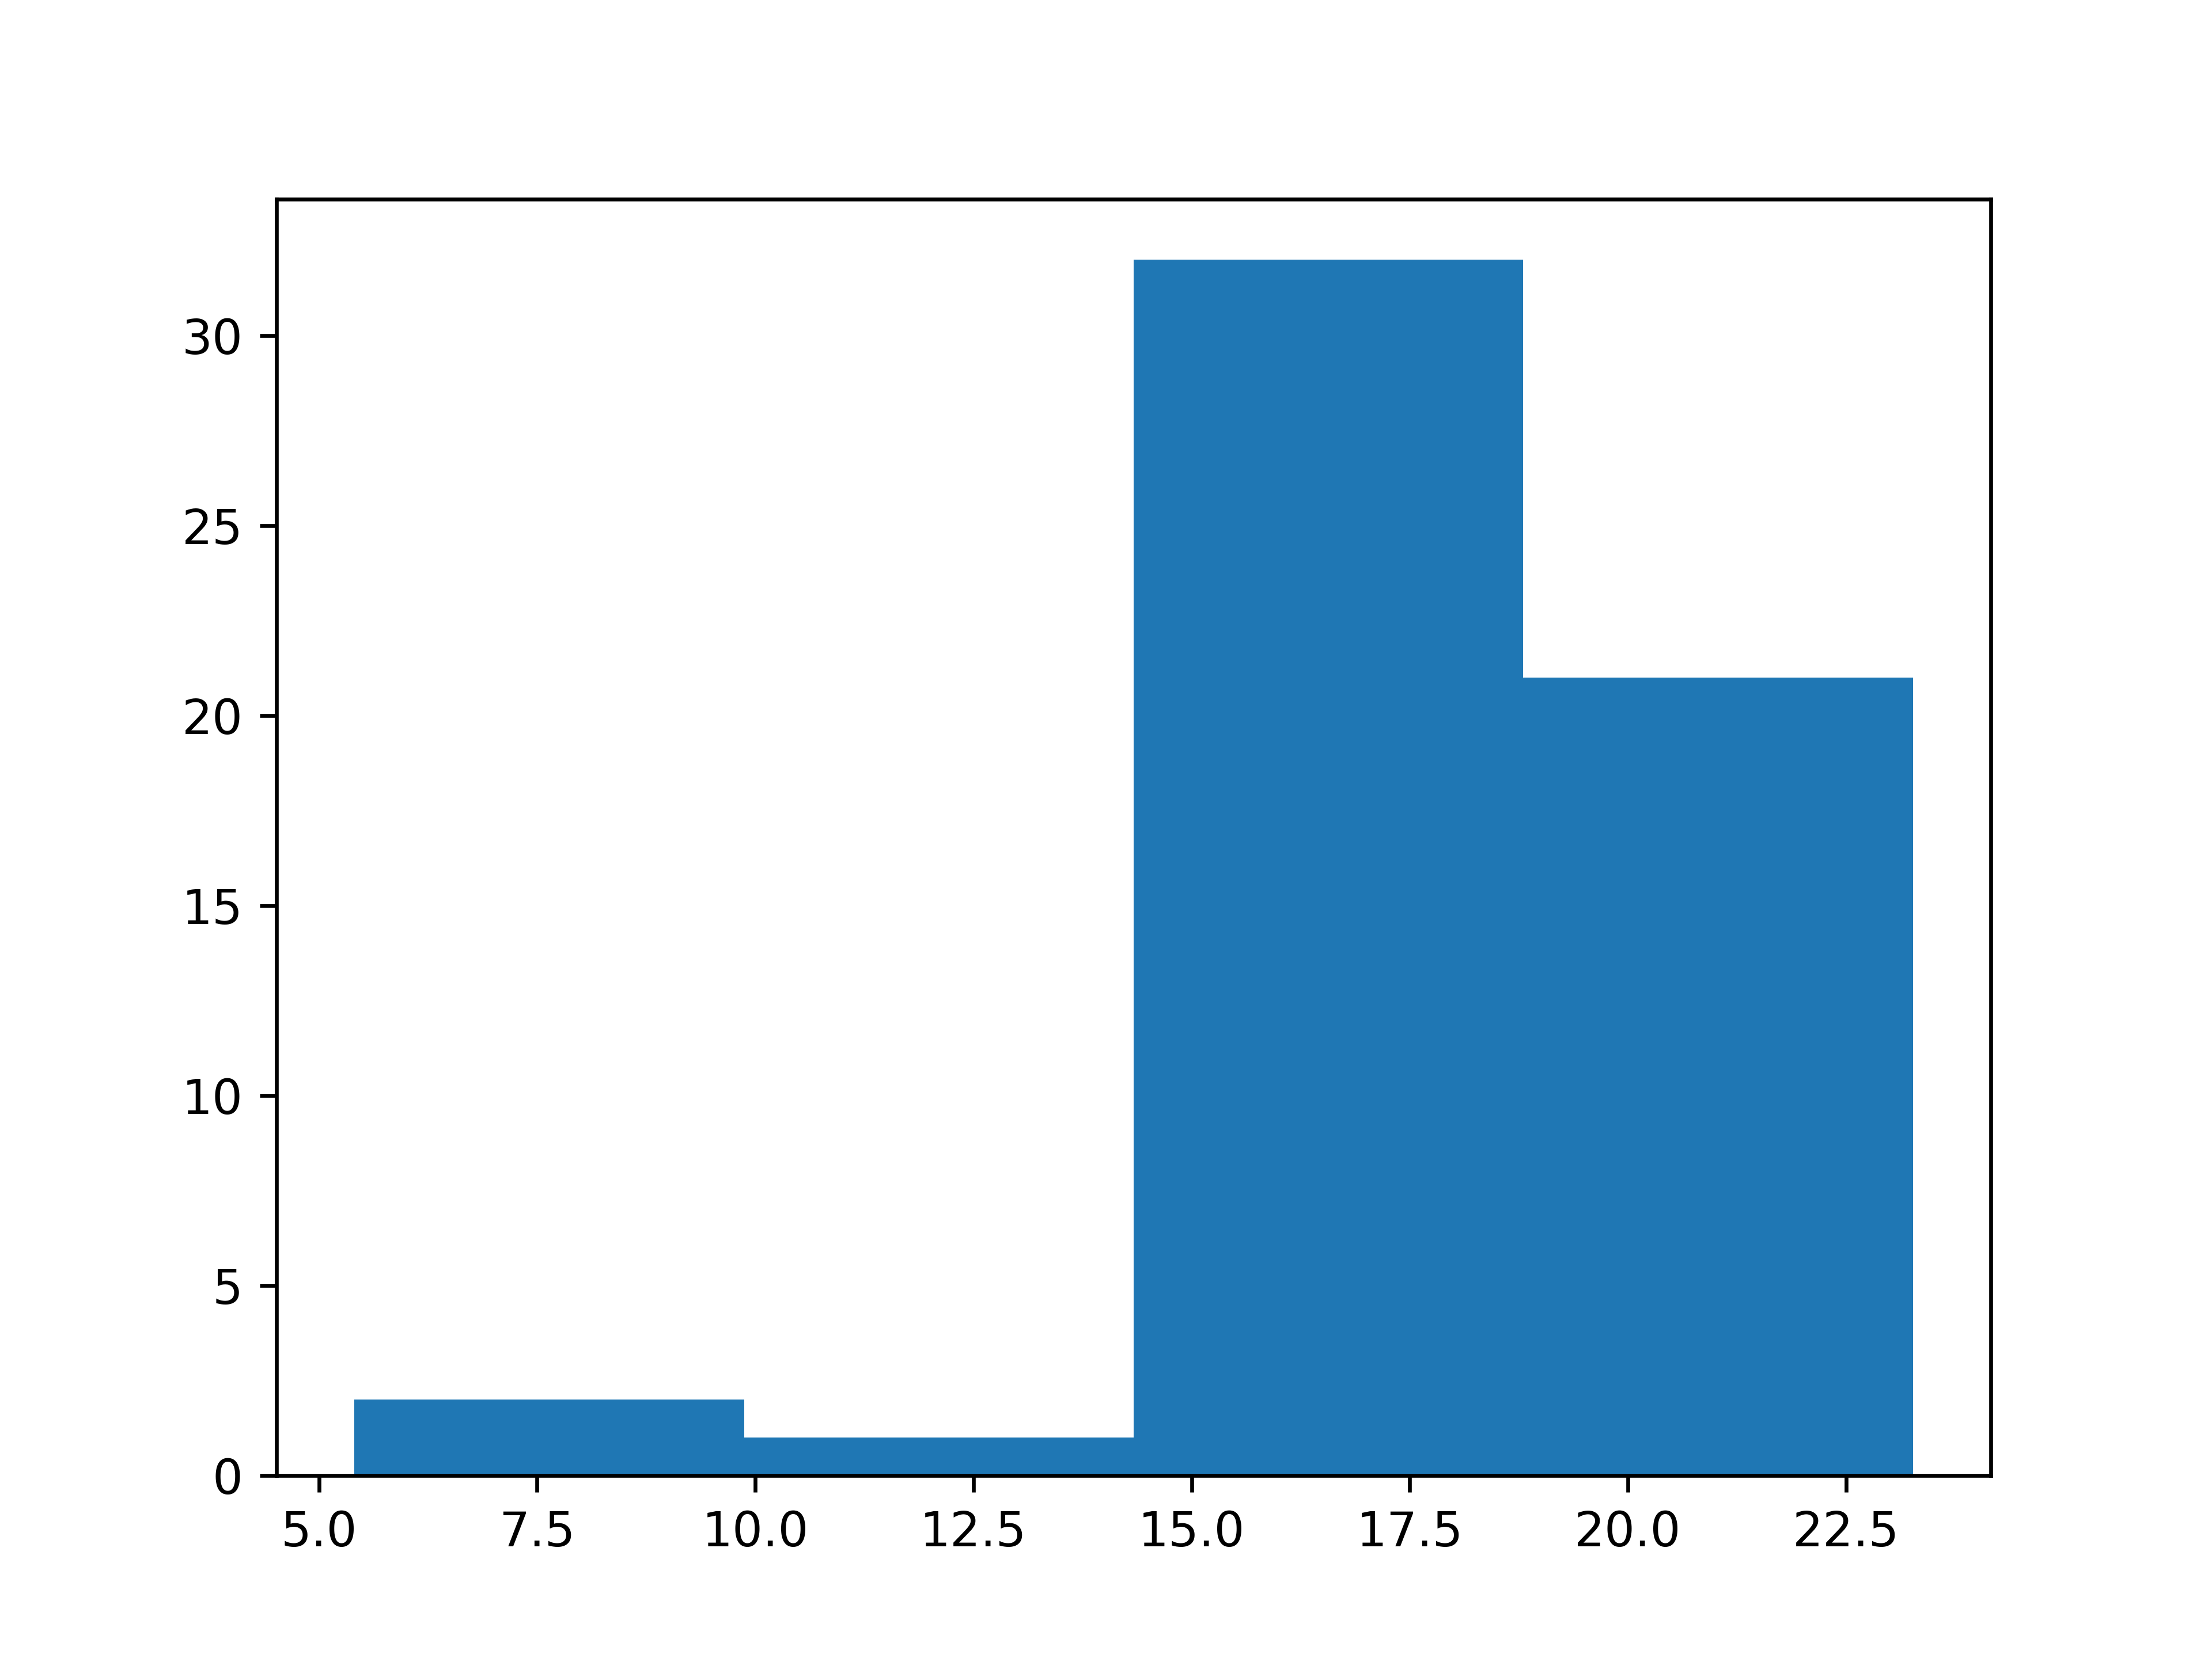
Figure 5a
Number of Occurrences
Predicted KV40 (cSt)
Figure 5a: Histogram of VisCalcML-predicted KV40 for expert-curated C₃₀ molecules.

Slide 11
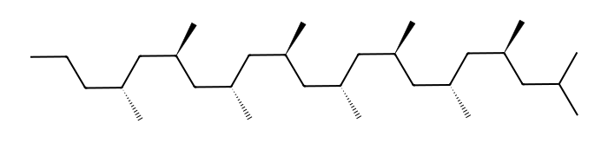
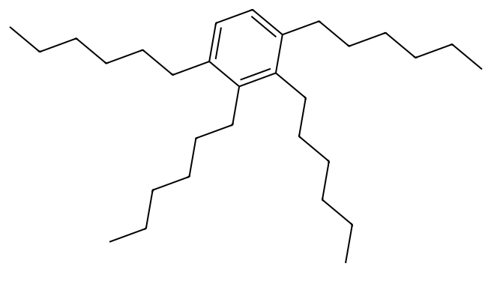
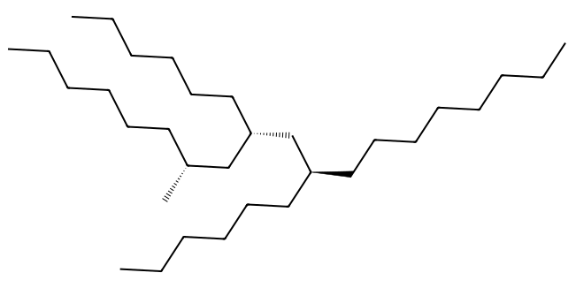
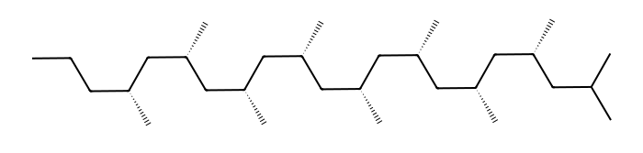
Figure 5b
SMILES strings from left to right (for reference):
1. (Left-top)
'CCC[C@@H](C)C[C@H](C)C[C@@H](C)C[C@H](C)C[C@@H](C)C[C@H](C)C[C@@H](C)C[C@H](C)CC(C)C’
2.(Left-bottom) 'CCC[C@@H](C)C[C@@H](C)C[C@@H](C)C[C@@H](C)C[C@@H](C)C[C@@H](C)C[C@@H](C)C[C@@H](C)CC(C)C’
3. (Middle)
'CCCCCCCC[C@@H](CCCCCC)C[C@@H](CCCCCC)C[C@H](C)CCCCCC’
4. (Right)
'CCCCCCc1ccc(CCCCCC)c(CCCCCC)c1CCCCCC'
5.41 cSt
23.27 cSt
19.17 cSt
Low Predicted KV40
High Predicted KV40
Figure 5b: Relative differences in VisCalcML-predicted KV40 for select expert-curated C₃₀ molecules.

Slide 12
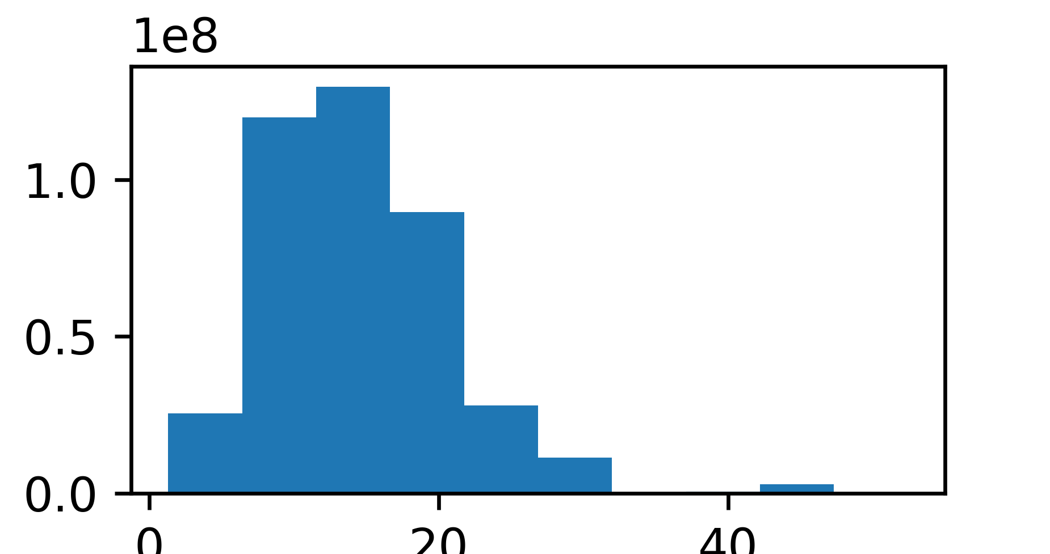
Figure 6
Occurrences (× 10⁸)
0
20
40
Predicted KV40 (cSt)
Console commands to generate this figure with make_histogram.py
cd ~/projects/VisCalcML/
git pull
# If you need my credentials, enter patrickwright8 as username
# Repo token is in a virtual sticky note
conda activate pao
python make_histogram.py

Slide 13
Fig. 5: Predicted KV40 of Sibo-Curated Molecules
Histogram of KV40 for all mols
Also, select a few interesting or representative examples and put on line plot to show structural differences between high and low KV

Slide 14
Fig. 6: Predicted KV40 of Surge Isomers
Histogram

Slide 15
Fig. 7: “Upper-Bound”-style Plot relating VI and Predicted KV40
Just an idea I thought was cool
Make a plot of VI vs KV40 for ~1000 randomly-selected Surge isomers
  Would be interesting if we see a “Robeson-style” upper bound tradeoff between the two
    Could make a connection between membranes and lubricants

Slide 16
SI Figures
Figures are put in preliminary order

Slide 17
Benchmarking 16 Models to Determine Top Performer
In theory this is a logical figure to include
However, the takeaways are fuzzy
  Several models score similarly, yet only the top model (starred) performs well on Test set
I prefer to put this in the SI

Slide 18
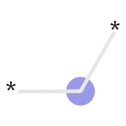
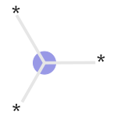

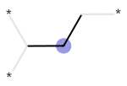
SHAP Plot
Positively Correlated with KV
2245384272
Acyclic 2° sp³ Carbon
2976033787
Cyclic 3° sp³ Carbon
3217380708
Cyclic 3° sp² Carbon
1583799011
Acyclic 2° sp³ Carbon
Temperature
Negatively Correlated with KV
Cool idea, but again, the takeaways are fuzzy

